Slide 1
Home
Documentation
Dashboard
Code
The Whaddon Show Api
Description
Performance
Documentation
Code

Slide 2
Home
Documentation
Dashboard
Code
The Whaddon Show Api
Description
Performance
Documentation
Code

Slide 3
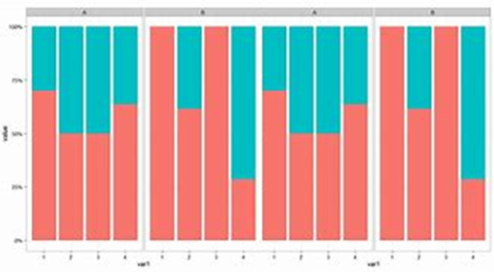
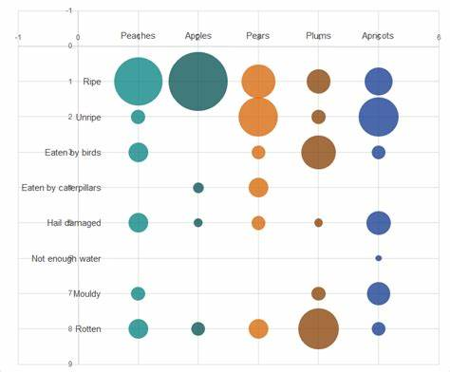
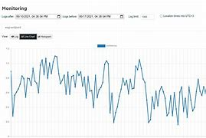
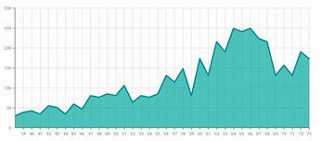
Pagination
Home
Documentation
Dashboard
Code
The Whaddon Show Api - Dashboard
Current Performance (last 3 hours)
Controller Testing (4th Jun – 11th Jun)
Reliability
100%
150ms
Reliability
Reliability
Avg call speed
Controller/Test Breakdown
100%
150ms
Fgfghfhgfoiioi ssfsdfsdv sfdvsd sdfdvf ssdvfdsdoerigreiogjeriojgioreger
Fgfghfhgfoiioi ssfsdfsdv sfdvsd sdfdvf ssdvfdsd jijeoiefjioerjoier
Fgfghfhgfoiioi ssfsdfsdv sfdvsd sdfdvf ssdvfdsdigreiogjeriojgioreger
Availability
Speed
Availability
Fgfghfhgfoiioi sfdvf ssdvfdsd jijeoiefjioerjoierjgoerigreiogjeriojgioreger
Fgfghfhgfoiioi sfdvf ssdvfdsd jijeoiefjioerjoierjgoerigreiogjeriojgioreger

Slide 4
Home
Documentation
Dashboard
Code
The Whaddon Show Api
The Whaddon Show Api
MyApiMonitor

